Slide 1
BLOOD DONATION MOBILE APPLICATION WITH PROXIMITY CHECK Presented By NGAKO TCHAWE ANDY MANUELA 19SI-004362 Software Engineering
Supervisor: Dr Mokom Felicitas July 2023

Slide 2
Table of contents
01
02
03
04
Introduction
Methodology
Implementation and Results
Conclusion

Slide 3
01
Introduction

Slide 4
Key Words
Blood
Blood Donation
Blood Transfusion
Blood Donation System
RESTful API

Slide 5
Problem Statement
With blood banks running low and donations continuing to drop-off across the country, many people lose their lives, time and even money to find compatible blood donors for urgent transfusions.

Slide 6
Objectives
1. Enable patients to post blood requests and receive potential donors’ feedbacks according to proximity check and proposed blood group.
2. To notify those potential donors about urgent blood request without them being necessarily logged in into the system.
3. A chatbot that will enable users to get adequate information about blood donation conditions to be respected and campaigns available.

Slide 7
Related Works
American Red Cross Blood Donor Application
Lifeblood Donor Application
BLOODR: blood donor and requester mobile application

Slide 8
02
Methodology

Slide 9





Tools and Technologies Used

Slide 10
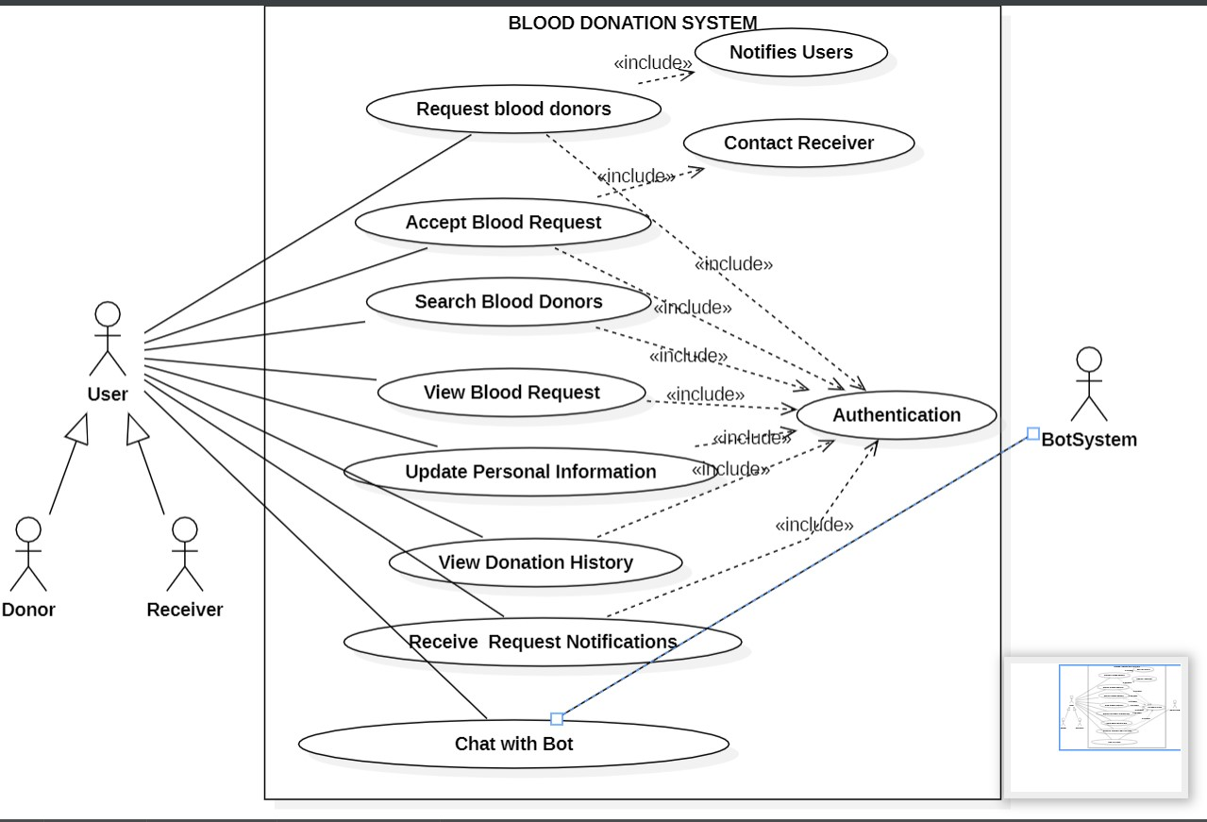
UML Diagrams Use Case

Slide 11
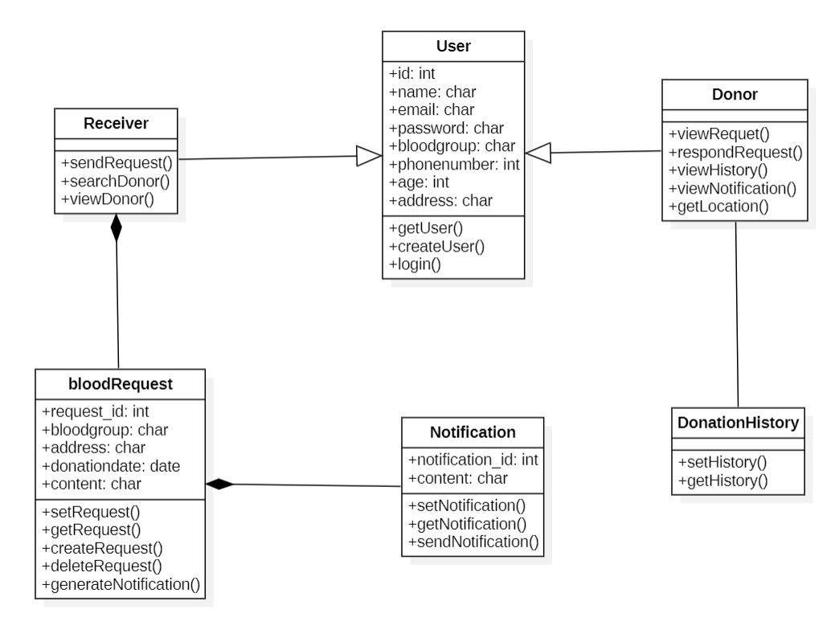
Class Diagram

Slide 12
03
Implementation

Slide 13
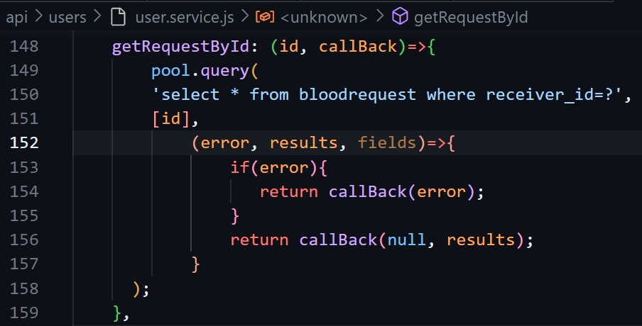
API Service

Slide 14
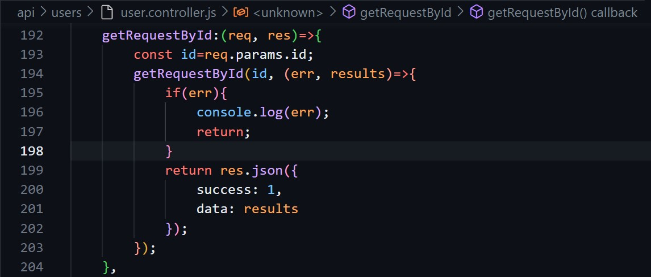
API Controller

Slide 15
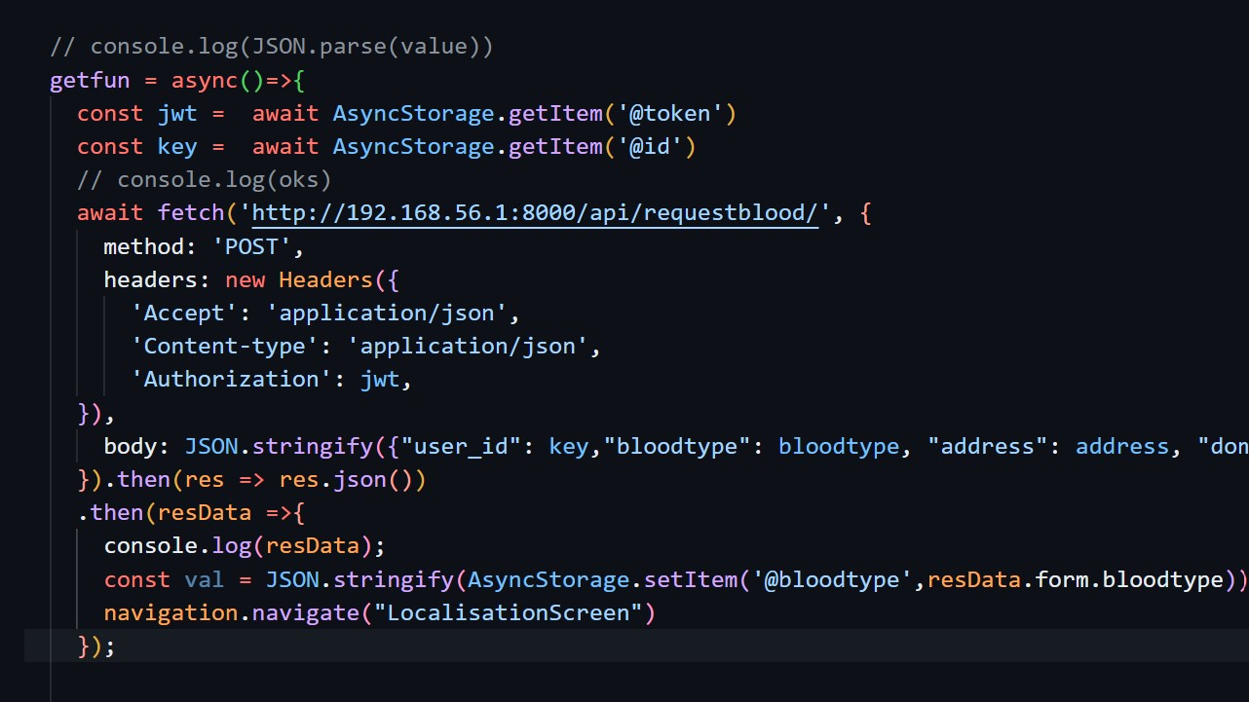
API Consumption

Slide 16
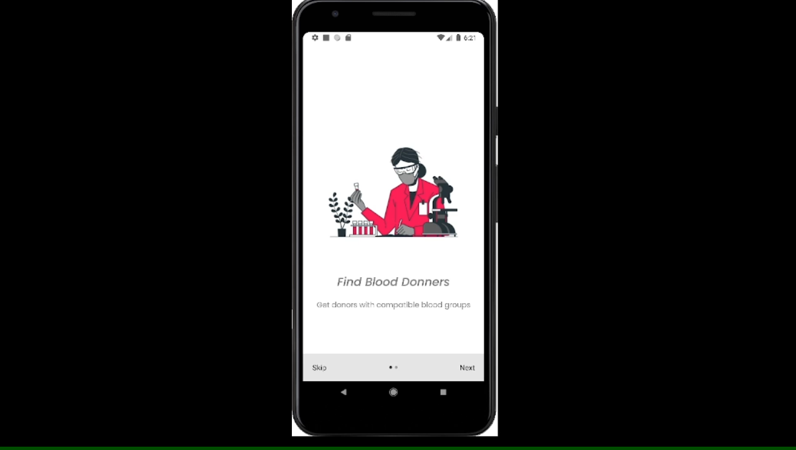
Results

Slide 17
04
Conclusion

Slide 18
Future Work
1. Adding a gaming feature in to the mobile application which will enhance and motivates donors’ experiences.
2. Earn achievement badges each time a donation is made.
3. Use react native health kit to get users’ biometric and heath data.

Slide 19
Conclusion
This application reduces time consumption to a greater extent used for searching for blood donors of the required blood group at a particular location. Thus this blood donation application provides the required results in less time and also helps in saving lives. Blood donation should be an everyday plebiscite in Cameroon to the benefit of present and upcoming generations, for every blood donation is a gift of life.

Slide 20
Thanks!
Any questions?

